Slide 1
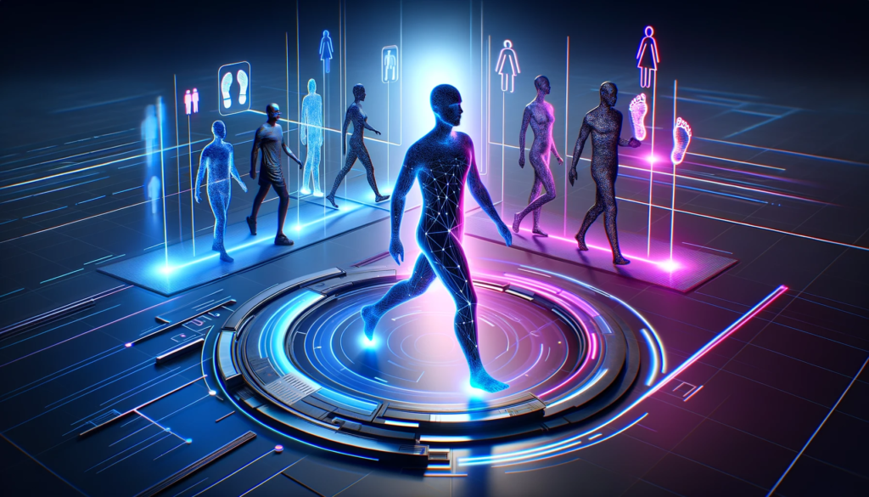
Gait Recognition
Final project
Year : 3rd year
NM.ID : au421221104042
Email.id : sudarsank725@gmail.com
By,
Sudarsan k

Slide 2
Agenda
Introduction to Gait Recognition
What is gait recognition
Importance of Gait Recognition
Applications of Gait Recognition
How Gait Recognition Works
Advantages of Gait Recognition
Challenges and limitations
Gait recognition in security and surveillance
Conclusion

Slide 3

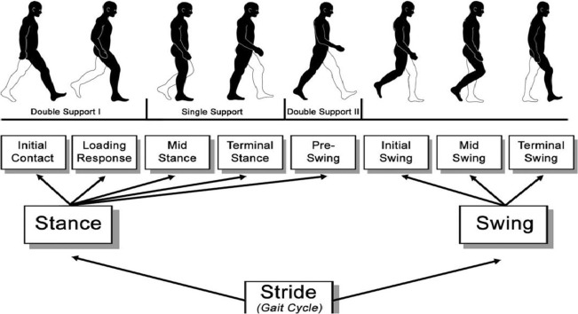

Introduction to Gait Recognition
Gait recognition is a cutting-edge technology that analyzes a person's unique walking pattern to identify them.
By utilizing various biometric cues such as the length of stride and the angle of the foot, gait recognition provides a non-invasive method of authentication and surveillance.
by Sudarsan K

Slide 4

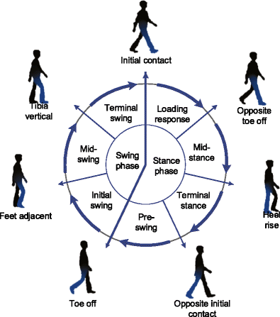
What is gait recognition?
Gait recognition is a biometric technology that identifies individuals based on their unique walking patterns. It uses computer vision and machine learning to analyze the movement and rhythm of a person's gait, often utilizing AI algorithms to process and identify distinct features. This technology has applications in security, surveillance, and healthcare.

Slide 5
Importance of Gait Recognition
Enhanced Security
Biometric Authentication
Gait recognition provides an additional layer of security in identifying individuals.
It offers a unique and reliable method for biometric authentication and access control.
Forensic Investigation
Medical Applications
Gait analysis can be crucial in criminal investigations and forensics for identifying suspects.
Gait recognition technology has potential medical uses, such as diagnosing and monitoring certain health conditions.

Slide 6




Applications of Gait Recognition
Security & Surveillance
Healthcare
Access Control
Person Identification
It plays a role in healthcare for patient monitoring and personalized care.
Gait recognition is employed for access control in high-security environments.
Gait recognition is utilized for enhancing security measures in public spaces.
It aids in identifying individuals in scenarios where facial recognition is not feasible.

Slide 7
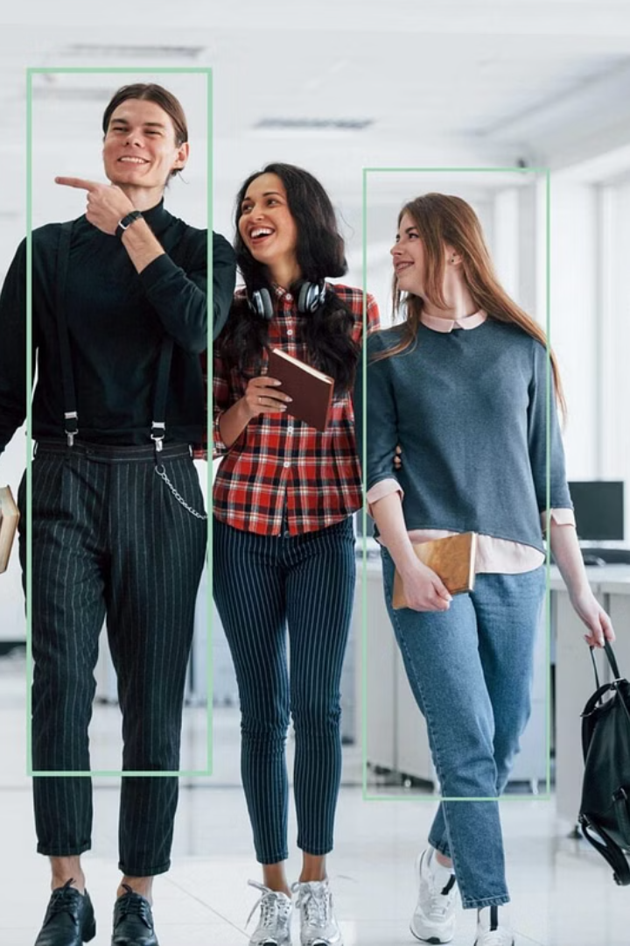
How Gait Recognition Works
Gait recognition works by analyzing an individual's walking pattern or the movement of their body. It uses biometric data from the way a person walks to create a unique identifier.
The technology captures features like step length, angle of toe-in/toe-out, and the motion of the body to distinguish individuals.

Slide 8


Advantages of Gait Recognition
Enhanced Security: Gait recognition provides an additional layer of security in sensitive areas.
Non-Intrusive: Unlike other biometric methods, it can be performed from a distance without physical contact.
Unique Identification: Each person's gait is distinctive, making it difficult to tamper with or replicate.

Slide 9
Challenges and limitations
Data Privacy Concerns
1
Rising concerns about data protection and privacy regulations.
Environmental Variability
2
Adaptation to different environmental conditions for accurate recognition.
User Acceptance
3
Ensuring user acceptance and willingness to participate in gait recognition systems.
Performance in Crowded Areas
4
Challenges in accurate recognition in crowded or complex environments.

Slide 10
Future of Gait Recognition Technology
Enhanced Accuracy and Speed
Integration with IoT Devices
Privacy and Ethical Considerations
AI and Machine Learning Integration
New advancements in technology will lead to increased accuracy and real-time recognition capabilities.
Gait recognition is expected to be integrated with Internet of Things (IoT) devices for seamless security applications.
As the technology evolves, there will be a growing emphasis on addressing privacy concerns and ethical implications.
The future will see further integration of gait recognition with AI and machine learning to enhance decision-making and analysis.

Slide 11
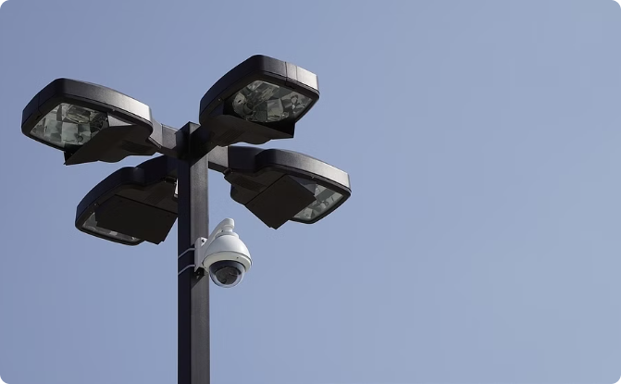
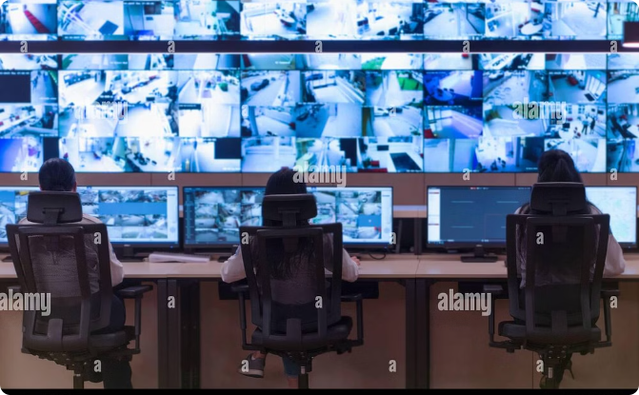
Gait recognition in security and surveillance
City Surveillance
Crowd Monitoring
Gait recognition plays a crucial role in city surveillance, monitoring pedestrian movement for security purposes.
It assists security personnel in analyzing walking patterns within crowds, identifying suspicious behaviors or individuals.

Slide 12

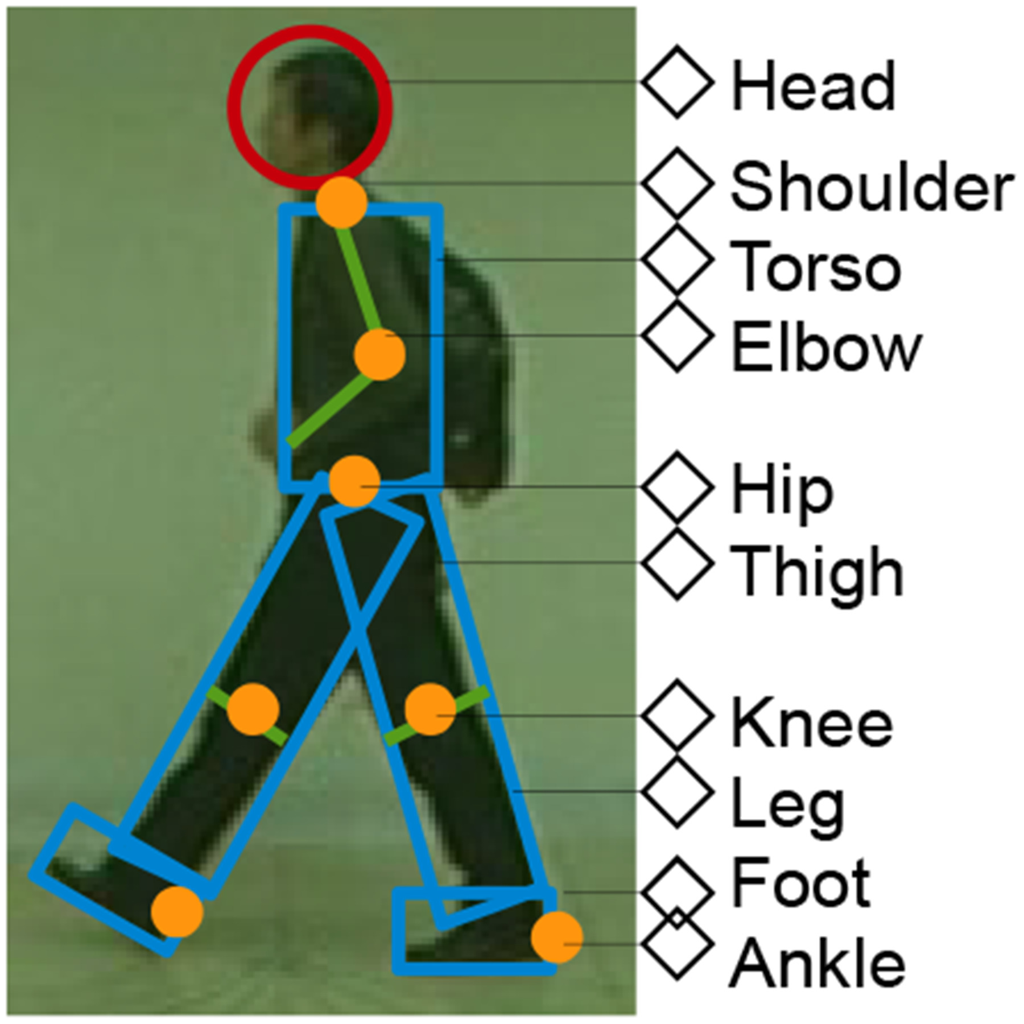
Conclusion
In conclusion, gait recognition technology has the potential to revolutionize security and surveillance systems. Its ability to identify individuals based on their unique walking patterns opens up new possibilities for enhancing safety and security in various public and private settings.

